Slide 1
ENHANCING OPERATIONAL EFFICIENCY, SPACE AND INVENTORY MANAGEMENT AT ‘JJ BEAUTY SALON’
Kalavagunta Sai Sri Lekha | 23f2003461 | May 2025 Term
BUSINESS DATA MANAGEMENT PROJECT PRESENTATION

Slide 2
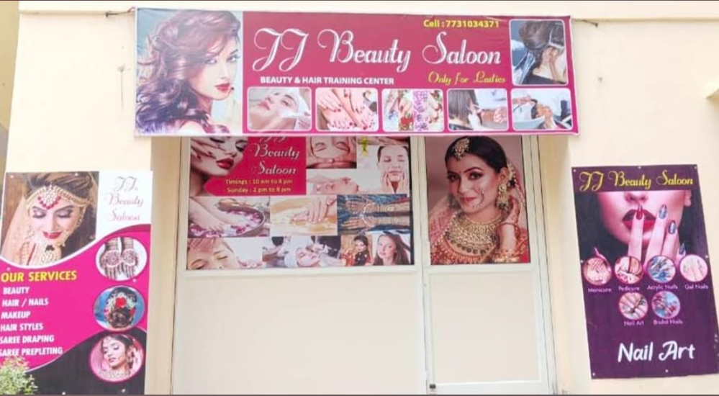
JJ Beauty Salon, a B2C established in August 2024 by Mrs. Janet Elisha, offers various beauty services including home options.
The salon faces challenges with space, manual inventory, and inefficient paper-based appointment scheduling.

Slide 3
Services Provided by Salon
Eyebrow Threading
Keratin Treatment
Bridal Makeup
Nail Extensions
Saree Draping
Back Massage
D-Tan
Facial
Nail Art

Slide 4
Problems
JJ Beauty Salon faces inefficiencies due to manual appointment scheduling, inventory tracking, and record-keeping, causing long wait times, stock issues, and limited business insights.
Data Collected
Data was collected directly from the salon owner’s handwritten records, covering services rendered, fees charged, and inventory usage. The analysis period was Feb 1st to March 4th, 2025.
Methods of Analysis
Pareto Analysis, ABC Analysis, Revenue Summary and Descriptive Statistics.

Slide 5
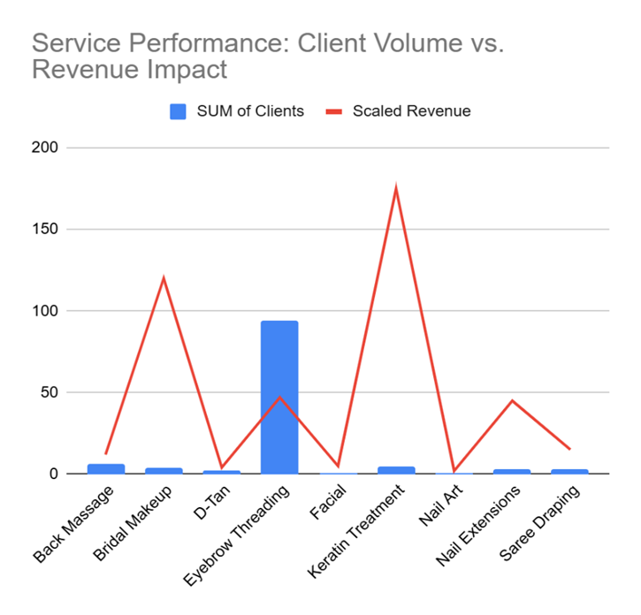
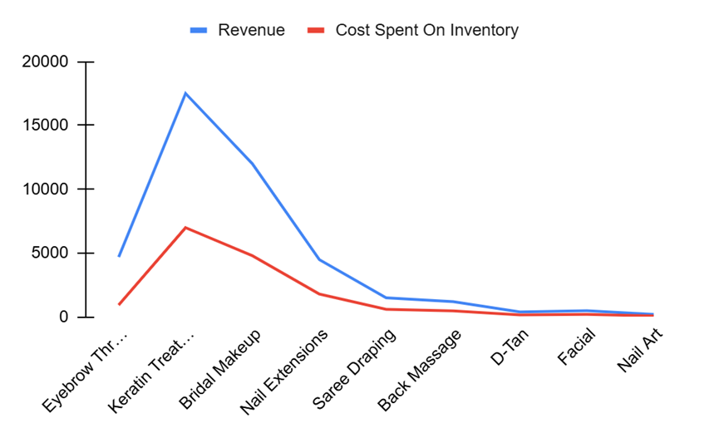
Service Performance and Inventory Cost Overview
Figure 2
Figure 1
Keratin treatments and bridal makeup bring in big earnings but also demand more resources, while everyday services like eyebrow threading and facials keep things running with low costs and high volume like ‘threading’ attracting lots of frequent clients at lower prices, and the premium services staying less frequent but highly profitable.

Slide 6
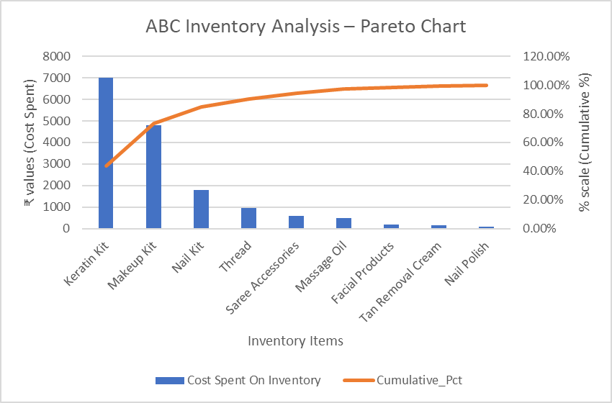
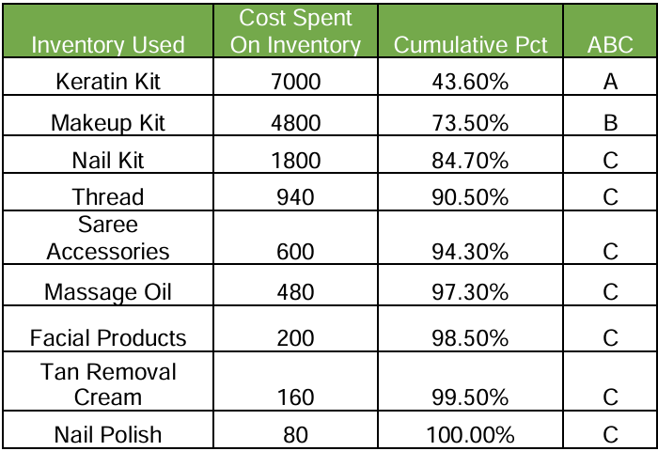
ABC Analysis
Table 1
Figure 3
The ABC analysis and Pareto chart show that the Keratin Kit alone drives over 43% of inventory costs, making it a critical 'A' item for close monitoring, while the Makeup Kit falls into the 'B' category with moderate importance. All other items form the low-impact 'C' group, highlighting that a few key products dominate spending and should guide JJ Beauty Salon’s inventory planning.

Slide 7
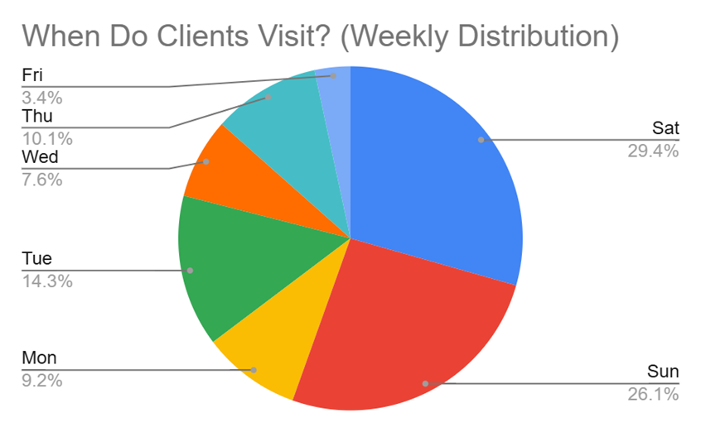
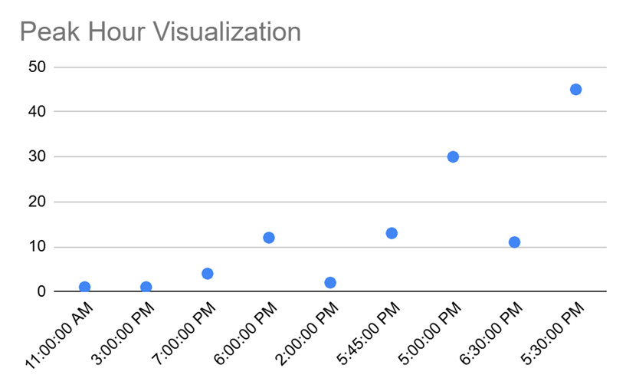
Appointment Concentration: Weekend and Evening Insights
Figure 4
Figure 5
At JJ Beauty Salon, weekends clearly dominate appointment bookings, with more than half of all visits concentrated on Saturday (29.4%) and Sunday (26.1%), confirming these days as the peak periods of activity. In addition to the weekend surge, there is also a strong concentration of appointments during the late afternoon to early evening hours, particularly between 5:00 PM and 6:30 PM. The sharpest spike is observed around 5:30 PM, reflecting customer preferences for visiting after work or school, when it is most convenient for them.

Slide 8
Recommendations
Service and Staffing Optimization
Segment Services: Identify high-frequency and high-margin services.
Allocate Staff: Assign quick staff to frequent services and schedule high-margin services during low-traffic hours.
Review Long Services: Adjust pricing or consider bundling for time-consuming services.
Adjust Staffing: Increase weekend coverage, use midweek for internal tasks, and align shifts with peak hours (5:00–6:30 PM).
Inventory Planning
Prioritize High-Impact Items: Focus procurement on 'A' and 'B' category items from the ABC inventory classification, especially the Keratin Kit and Makeup Kit, which together account for over 70% of total inventory costs.
Ensure Service Continuity: Maintain consistent availability of these critical items to support uninterrupted delivery of high-revenue services like Keratin Treatments and Bridal Makeup, which are key to overall business performance.
Monitor Low-Consumption Items: Keep track of low-consumption supplies such as threads, nail polishes, oils, and other minor items to prevent overstocking and reduce unnecessary inventory costs.

Slide 9
Recommendations
Client Demand, Promotions, and Service Packages
Weekday Offers: Create promotions to attract clients during slow periods.
Peak-Hour Management: Use pricing or reservation incentives to handle busy times.
Marketing Timing: Base campaigns on client visit patterns.
Bundled Packages: Offer service combos, bridal/event packages, or loyalty deals to increase bookings.
Off-Peak Promotions: Fill low-demand slots with discounted packages to maximize resource use.
Space Utilization
Optimize Layout: Dedicate floor space to high-frequency services like threading that require minimal equipment but high turnover.
Flexible Furniture: Use mobile trolleys and foldable furniture to free up space during service transitions.
Utilize Idle Areas: Convert unused corners or reception space into quick-service zones for express treatments.
Inventory Management: Store bulk inventory off-site, keeping only daily-use items at the salon to reduce congestion.

Slide 10
Thank you for your attention. Questions are welcome.
Kalavagunta Sai Sri Lekha | 23f2003461@ds.study.iitm.ac.in

